Slide 1
A Recommender System for Groceries Contractor
Applied Data Science Capstone
IBM Data Science Professional Certificate
January 2019

Slide 2
Business problem
Problem Description
In today's fast-paced and busy life in New York, it is unfeasible to go out and have three times meals in restaurants. Hence, online food delivery service will be best way to save their time and people can dedicate more time in their productive work/ Apart from that, they will have food from their favorite place of their taste and save money as well. Moreover, the online delivery service growing in New York city as forecasted by many agencies. Some of the facts are as follows:
Revenue in the Online Food Delivery segment amounts to US$18,358m in 2019.
Revenue is expected to show an annual growth rate (CAGR 2019-2023) of 7.3%, resulting in a market volume of US$24,345m by 2023.
The market's largest segment is Restaurant-to-Consumer Delivery with a market volume of US$16,162m in 2019.

Slide 3
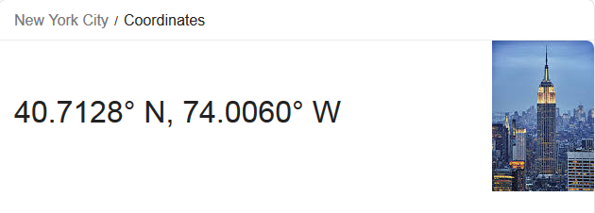
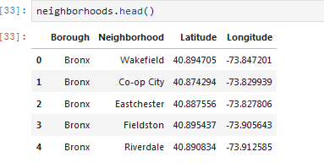
Business problem
Data We Need
We will need geo-locational information about that specific borough and the neighborhoods in that borough. I imported the json and geospatial data from https://cocl.us/new_york_dataset and http://cocl.us/Geospatial_data
image is retrieved
from google.com

Slide 4
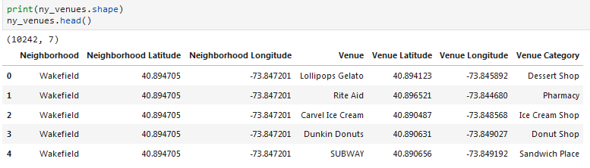
Synopsis
Data We Need
b) We will need data about different venues in different neighborhoods of that specific borough. In order to gain that information we will use "Foursquare" locational information. A typical request from Foursquare will provide us with the following information:

Slide 5
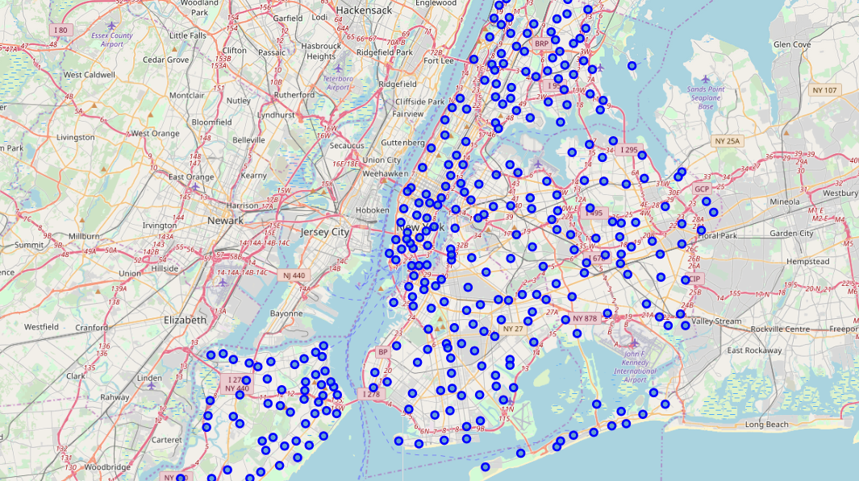
Main Article
Part 1: Identifying Offices and Restaurants in “NewYork"

Slide 6
Main Article
Part 2: Connecting to Foursquare and Retrieving Locational Data for Each Venue in Every Neighborhood
After finding the list of neighborhoods, we then connect to the Foursquare API to gather information about venues inside each and every neighborhood. For each neighborhood, we have chosen the radius to be 1000 meter. It means that we have asked Foursquare to find venues that are at most 1000 meter far from the center of the neighborhood.

Slide 7
Data PREPARATION
Part 3: Processing the Retrieved Data and Creating a DataFrome for All the Venues inside the New York
When the data is completely gathered, we will perform processing on that raw data to find our desirable features for each venue. Our main feature is the category of that venue. After this stage, the column "Venue's Category" will be One-hot encoded and different venues will have different feature-columns. After On-hot encoding we will integrate all restaurant columns to one column "Total Restaurants" and all food joint columns to "Total Joints" column.

Slide 8
Data PREParation
Part 3: Processing the Retrieved Data and Creating a DataFrome for All the Venues inside the New York

Slide 9
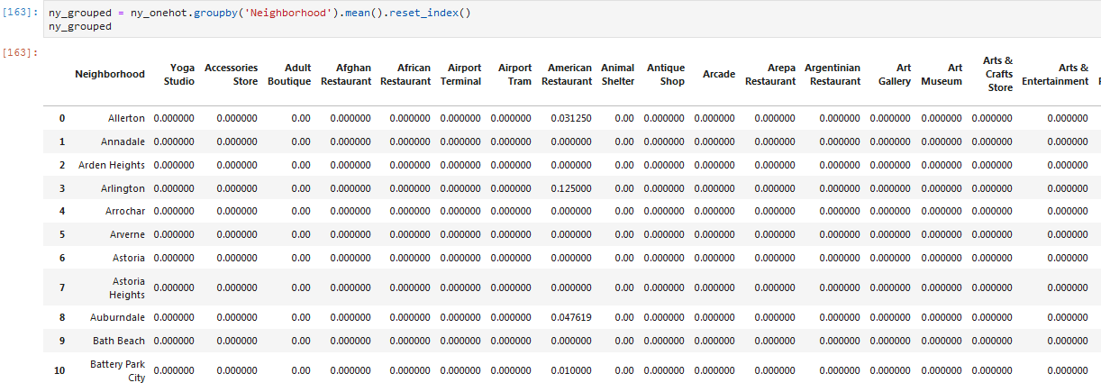
Model process
Now, the dataset is fully ready to be used for machine learning (and statistical analysis) purposes.

Slide 10
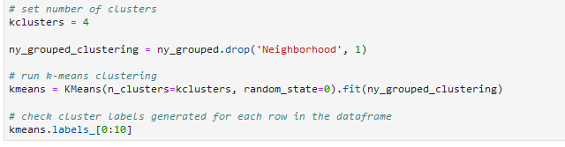
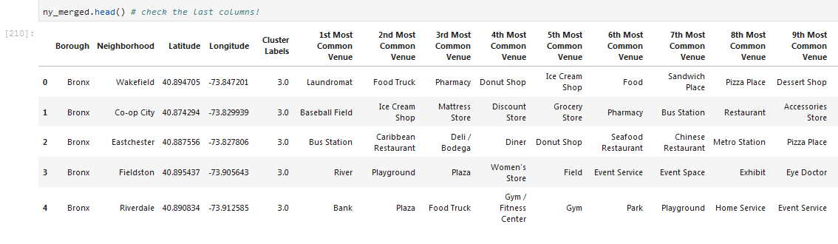
Main Article
Part 4: Applying K-Means Clustering

Slide 11
Decision Making and Reporting Results
Now, we focus on the centers of clusters and compare them for their "Total Restaurants" and their "Total Joints". The group which its center has the highest "Total Sum" will be our best recommendation to the contractor. {Note: Total Sum = Total Restaurants + Total Joints.} This algorithm although is pretty straightforward yet is strongly powerful.

Slide 12
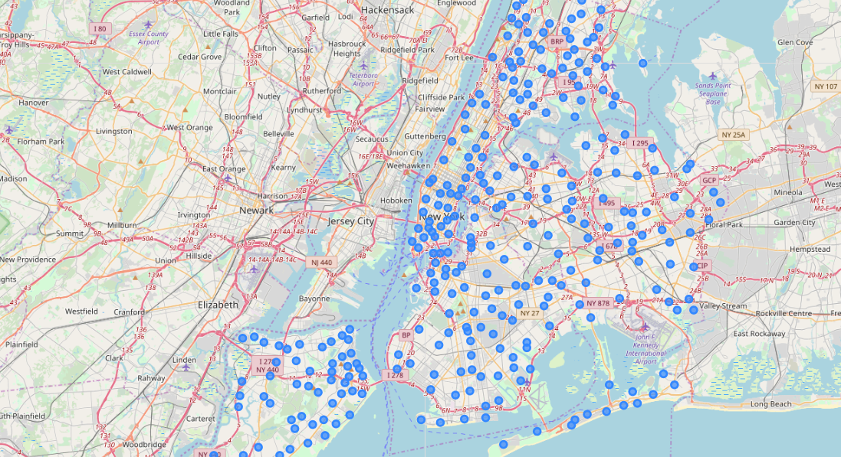
Decision Making and Reporting Results

Slide 13
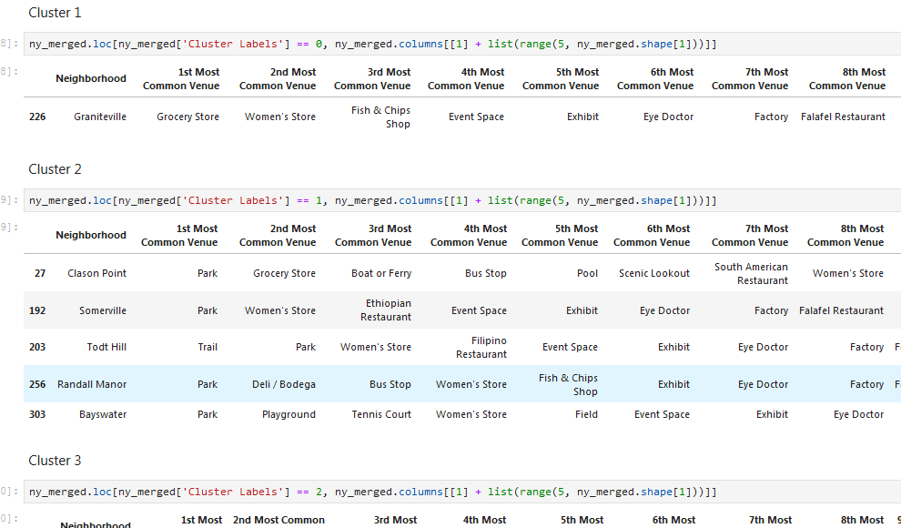
Decision Making and Reporting Results

Slide 14
Thankyou

